Slide 1
News Search Engine (Information Retrival Project) Sepehr Asgarian

Slide 2

RoadMap
Introduction
A short introduction
How this Search engine work
Steps
Preprocess
+
Posting list
+
TF-IDF
Code
Implementation
Search Engine
What is this project about
+
+
Results

Slide 3
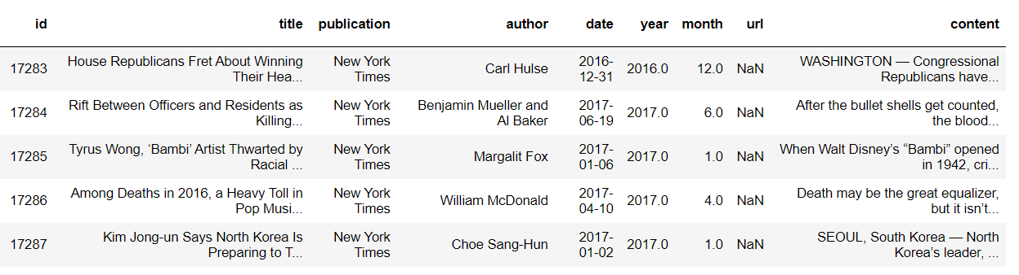
Introduction
What is the project about
Dataset
https://www.kaggle.com/snapcrack/all-the-news
Fig.1

Slide 4
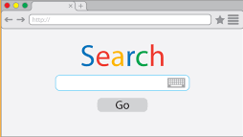
Search Engine
How this Search Engine work?
Preprocessing
Posting list
TF_IDF
Elimination index
Champion list
Fig.2

Slide 5
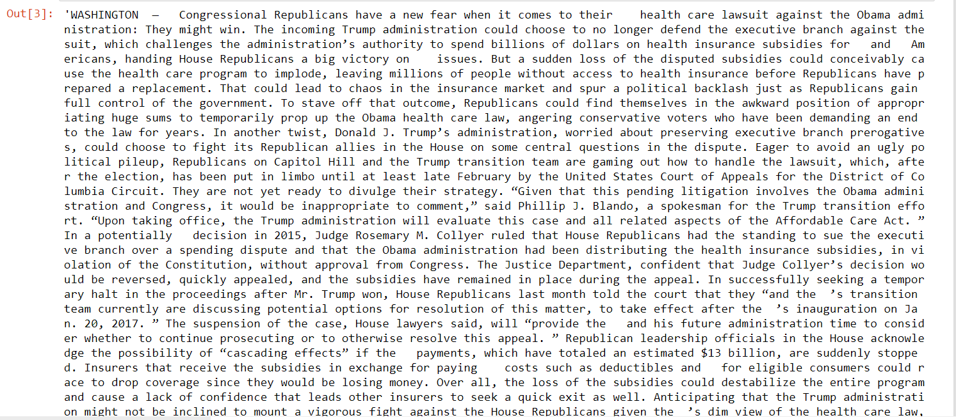
Steps
Preprocess
Fig.3

Slide 6
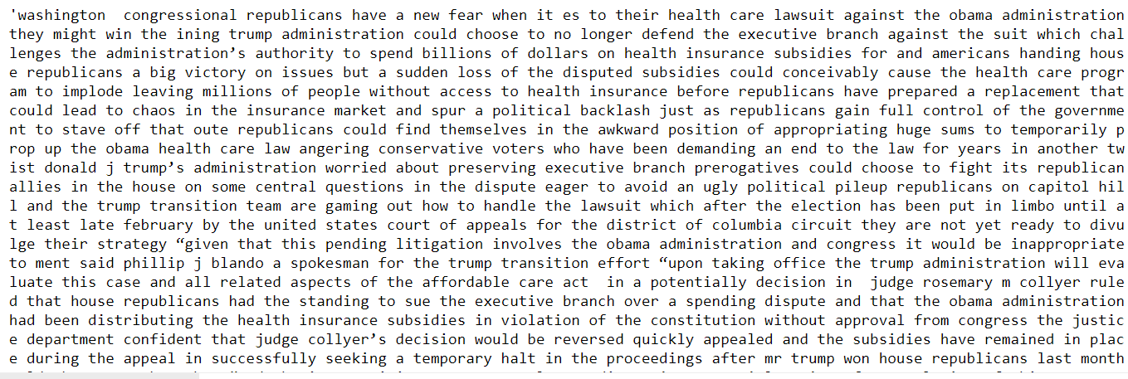
Steps
After a simple Preprocess
Fig.4

Slide 7
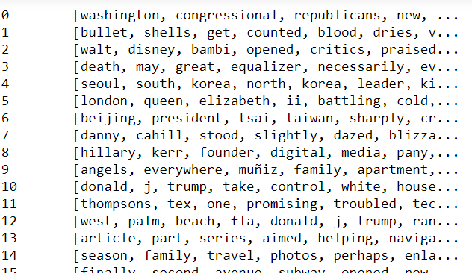
Steps
After Preprocess
Fig.5

Slide 8
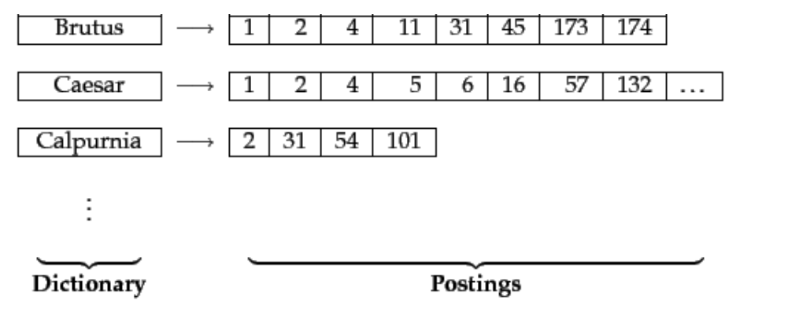
Steps
Posting list
Fig6[1]

Slide 9
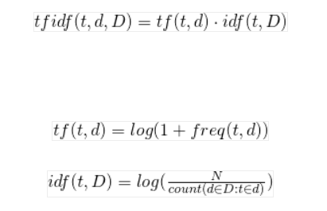
Steps
TF_IDF
Fig7[2]

Slide 10
let's start our search engine

Slide 11
Steps
Cosine similarity
Champion list
Elimination index

Slide 12
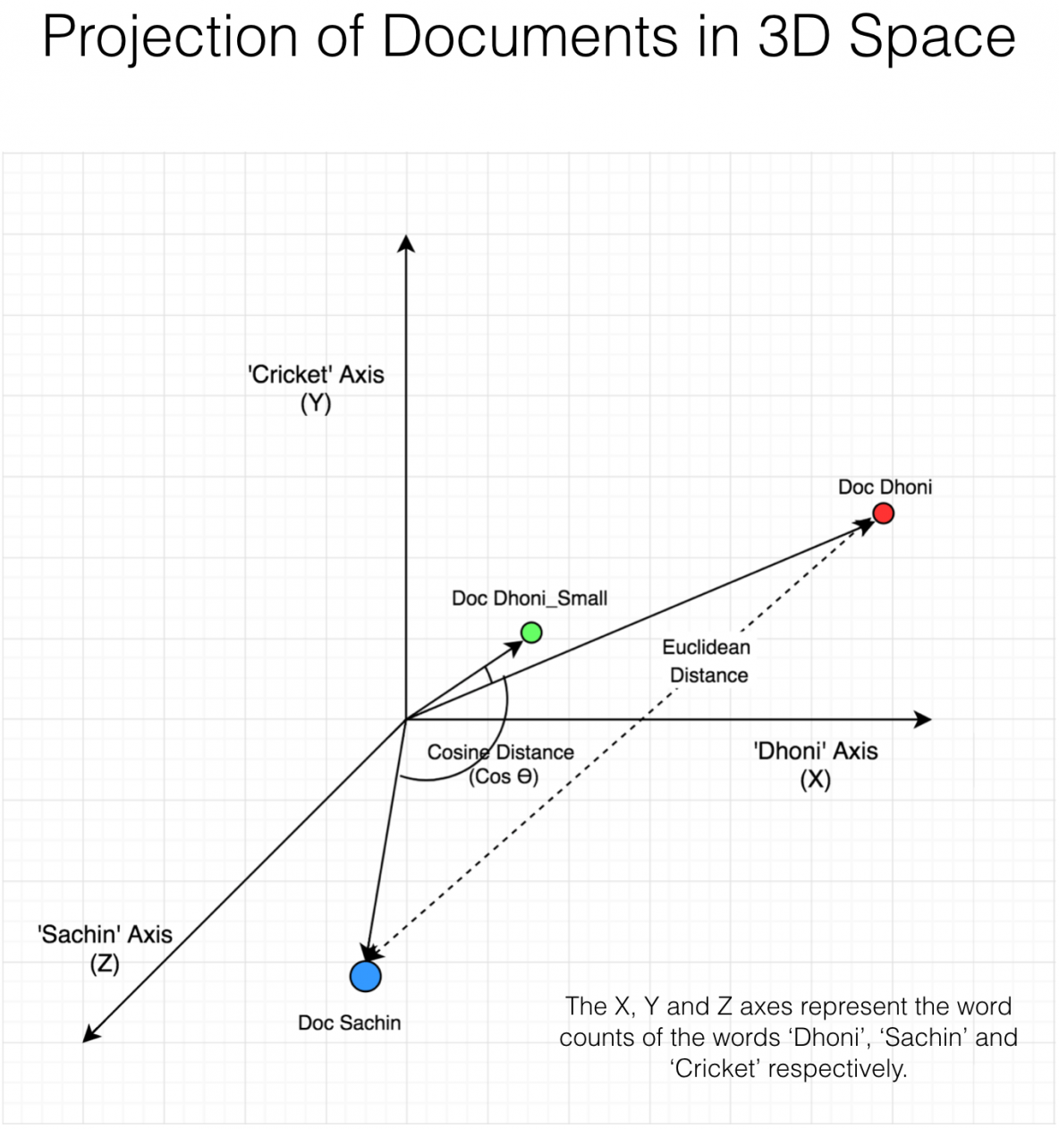
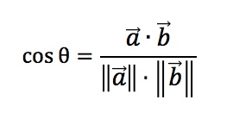
Steps
Cosine similarity
Fig.8[3]

Slide 13
Steps
Elimination index
Calculate cosine similarity with docs that have at least one query term.
Query: Stock good
Stock
good
Cosine similarity
123
245
789
2
123
245
789
2
123
789
Fig.4

Slide 14
Steps
Champion list
fear': [19901, 34329, 11060, 5937, 47113, 18250, 33256, 2967, 36259, 12663]
health': [48382, 20563, 1115, 40161, 15933, 22621, 12680, 18067, 513, 5429]
Fig.4

Slide 15
Thank You for your Attention!

Slide 16
References
[1] Auto-Encoder: What Is It? And What Is It Used For? (Part 1)
Will Badr, https://towardsdatascience.com/auto-encoder-what-is-it-and-what-is-it-used-for-part-1-3e5c6f017726
[2] (What is TF-IDF?, 2020)
Seyrek Otomatik Kodlayıcı (Sparse Autoencoder)
Author: veribilimcisi, https://veribilimcisi.com/2018/06/04/seyrek-otomatik-kodlayici-sparse-autoencoder
[3] (Cosine Similarity - Understanding the math and how it works? (with python), 2020)
[4] https://www.kaggle.com/snapcrack/all-the-news

